Slide 1

NSG Pilkington – University of Liverpool Machine Learning Project: 18/08/2020
Dr. Peter Green
Diego Echeverria
Risk Institute,
School of Engineering
11/08/2020

Slide 2
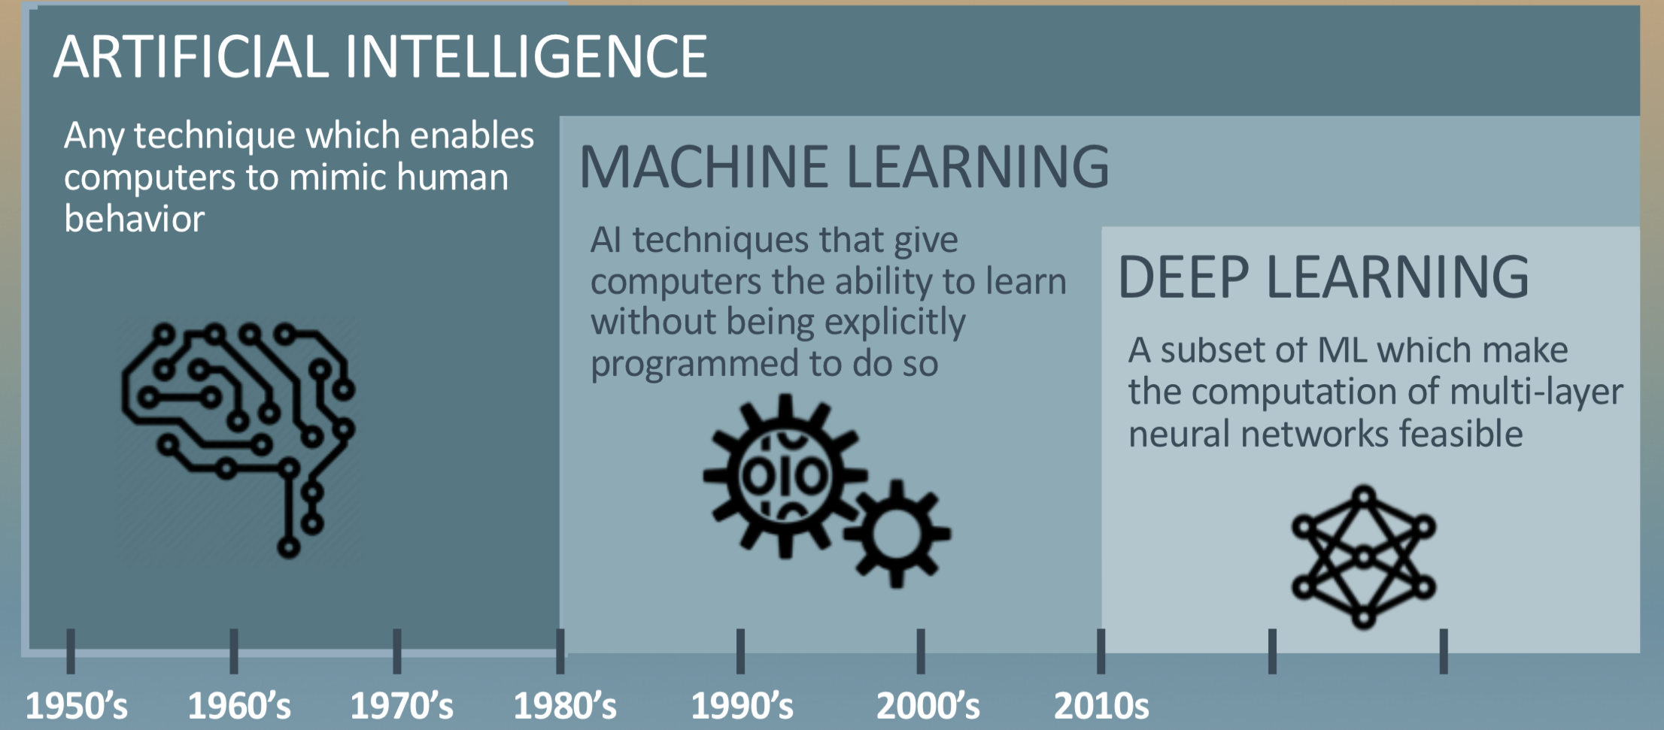
Machine Learning

Slide 3
Machine Learning
Machine Learning is a subarea of Artificial Intelligence.
AI: The ability of a machine to perform tasks usually associated with intelligent beings. For instance, a device that perceives its environment and takes actions that maximize its chance of successfully achieving its goals.
The term AI is often used to describe machines (or computers) that mimic "cognitive" functions that humans associate with the human mind, such as "learning" and "problem solving“.

Slide 4
Machine Learning
Machine Learning is a subarea of Artificial Intelligence.
Machine Learning: It is an application of AI that build a mathematical model based on sample data, known as "training data", in order to make predictions or decisions without being explicitly programmed to do so.
The primary aim is to allow the computers learn automatically without human intervention or assistance.
The performance of different ML algorithms strongly depends on the size and structure of your data.

Slide 5
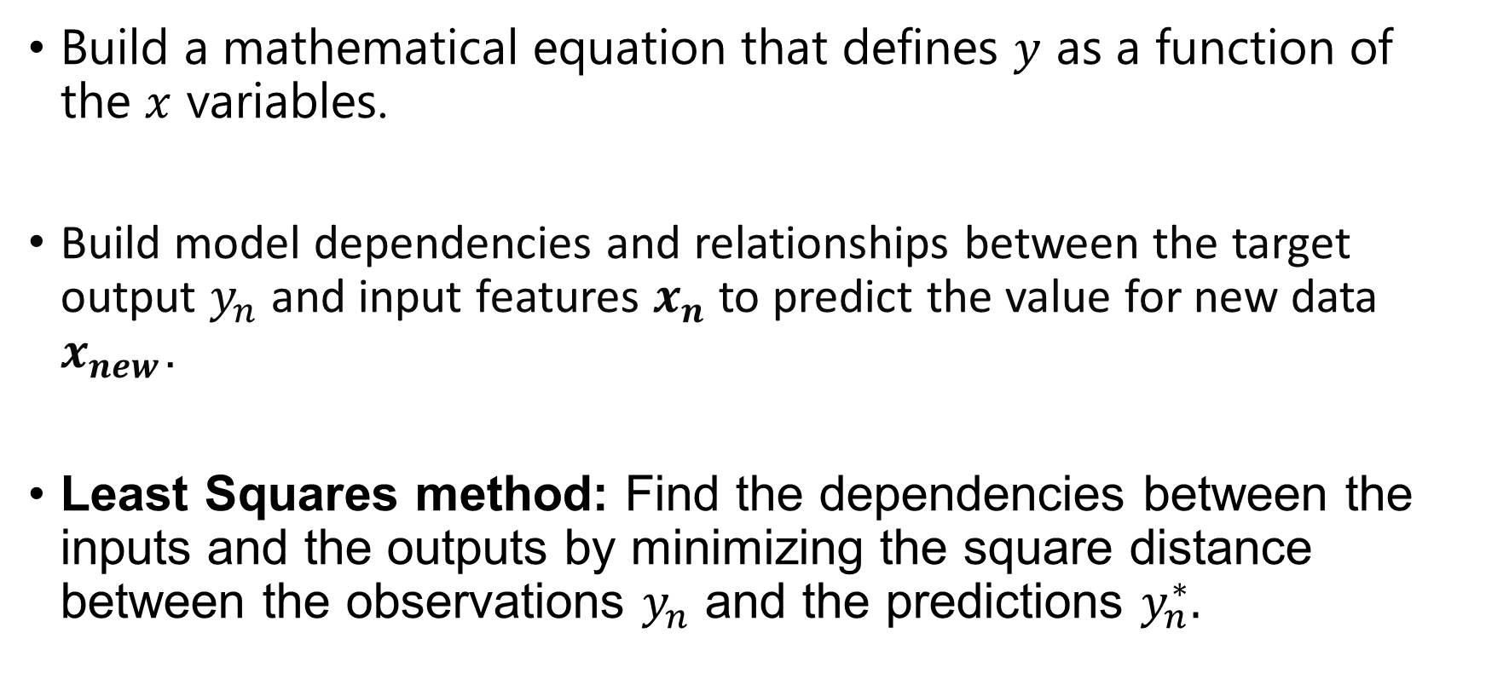
Regression using Machine Learning techniques
Build a mathematical equation that defines $y$ as a function of the $x$ variables.
Build model dependencies and relationships between the target output $y_{n}$ and input features $x_{n}$ to predict the value for new data $x_{new}$.
Least Squares method: Find the dependencies between the inputs and the outputs by minimizing the square distance between the observations $y_{n}$ and the predictions $y_{n}^{∗}.$

Slide 6

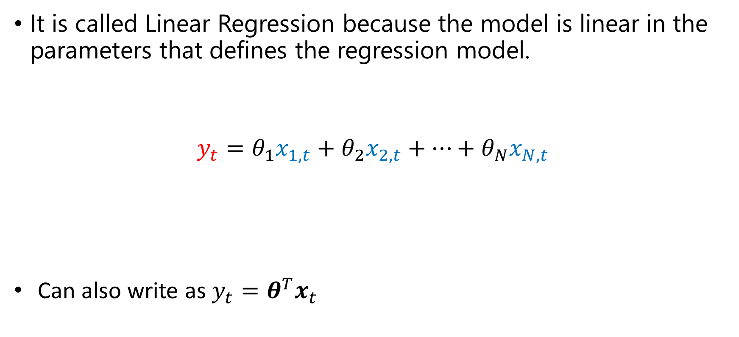

Linear Regression: Lest Squares
It is called Linear Regression because the model is linear in the parameters that defines the regression model.
$$y_{t}=θ_{1}x_{1,t}+θ_{2}x_{2,t}+…+θ_{N}x_{N,t}$$
Can also write as $y_{t}=θ^{T}x_{t}$
Total faults at time $t$
Tag data at time $t$

Slide 7
Regression using Machine Learning techniques
As we give more information about the latent process (Furnace Faults), the relationship between the inputs and outputs would be clearer to the ML algorithm.
Hence, incrementing the number of observations would ease the learning process.
In other words, we should be able to see how the model converge to a solution as we increase the number of observations.

Slide 8
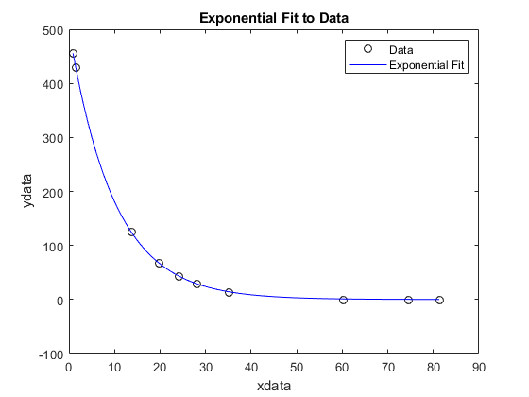
Linear regression: Least Squares
The model identifies the optimum parameter (converge to a solution) as we increment the number of observations.
One parameter associated with one input
Parameter / weight
N of observations

Slide 9
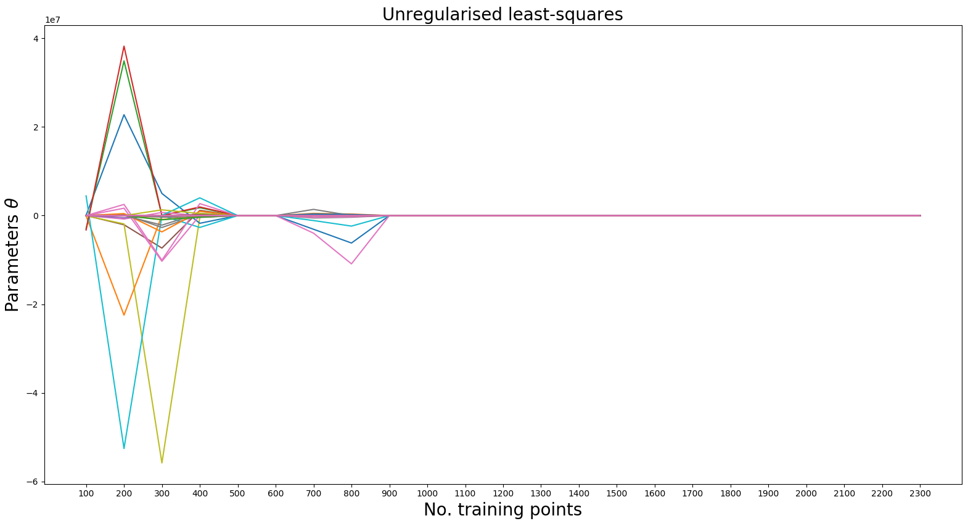
Linear regression: Least Squares
129 parameters associated with 129 inputs
Parameter / weight
N of observations

Slide 10
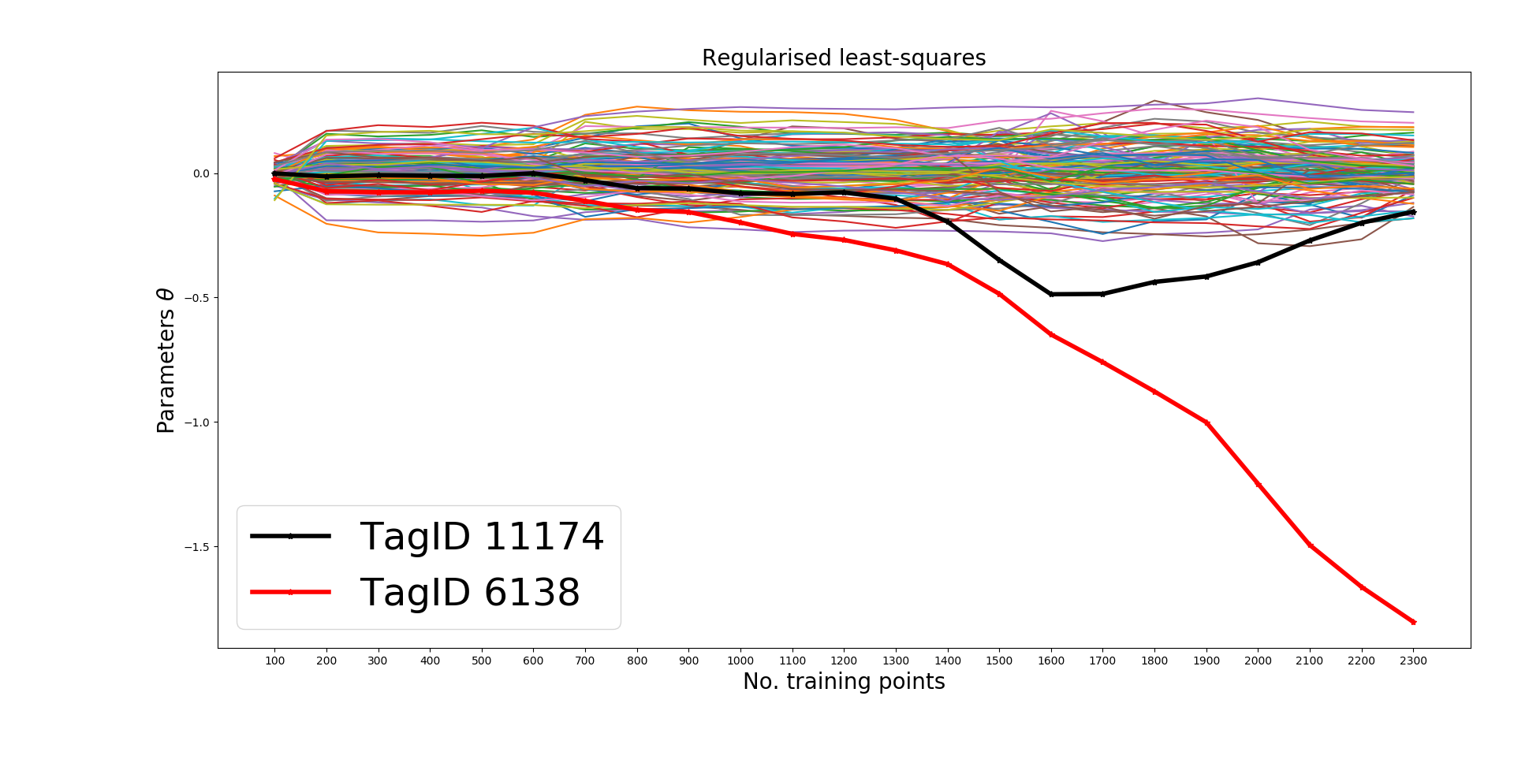
Linear regression: Regulasied Least Squares
129 parameters associated with 129 inputs

Slide 11
Conclusions
If the Regularised Least Squares parameters does not converge when increasing the training data, then we might be facing a regression problem with dynamic inputs.
Online Least Squares can update its parameters and thus capturing the dynamic behaviour of the inputs.

Slide 12
Thank you for your attention. ANY QUESTIONS?

